Slide 1
Eigen and visual studio C++

Slide 2
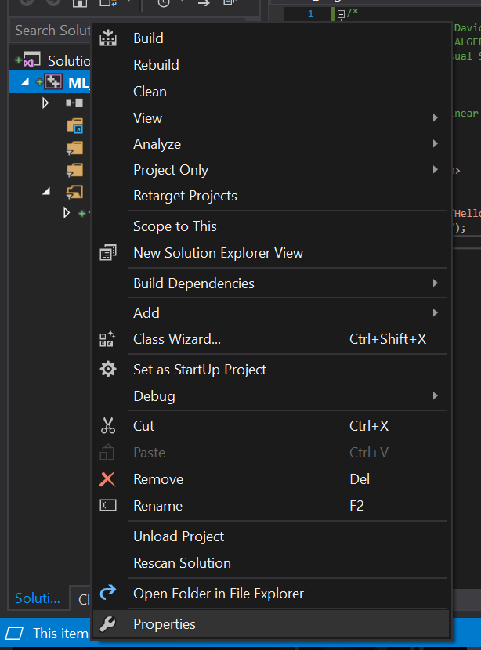
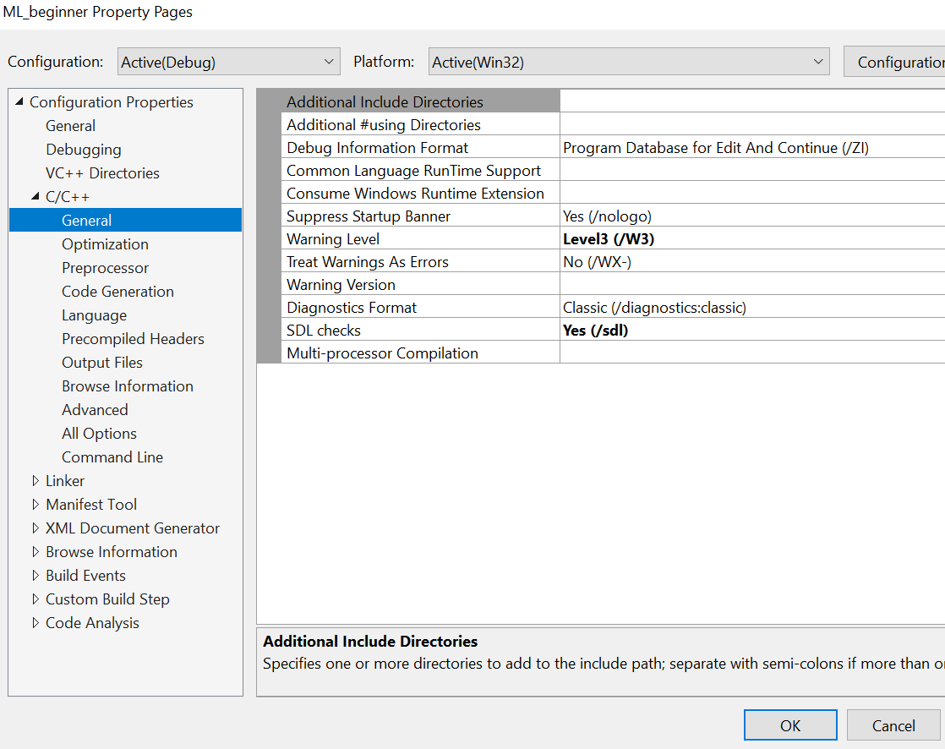
LOAD C++ EIGEN PACKAGE

Slide 3
